Slide 1
Online safety and screen time parent information session
Joel Edwards
Melane Karlsson
Phoebe Coulson
Notes:
Discuss questioning protocol. Write on a sticky note with name and email address for follow up. Or talk to us at the end.
It will be interactive so if you have a phone or device follow along

Slide 2
What do we already know?
Screens are a part of everyday life with most families owning multiple televisions, computers, tablets and gaming systems.
4/5 children are on social media by age 12.
6-in-10 kids don’t get enough sleep because of a screen.
The average age for a child to get their first smartphone is 11 years (and falling).

Slide 3
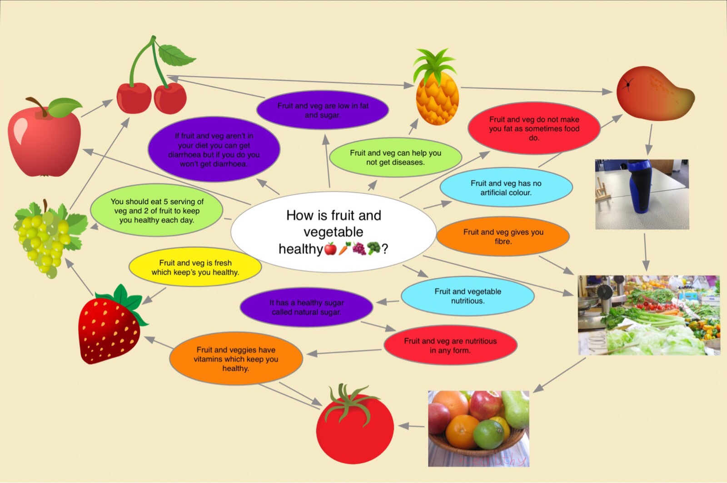
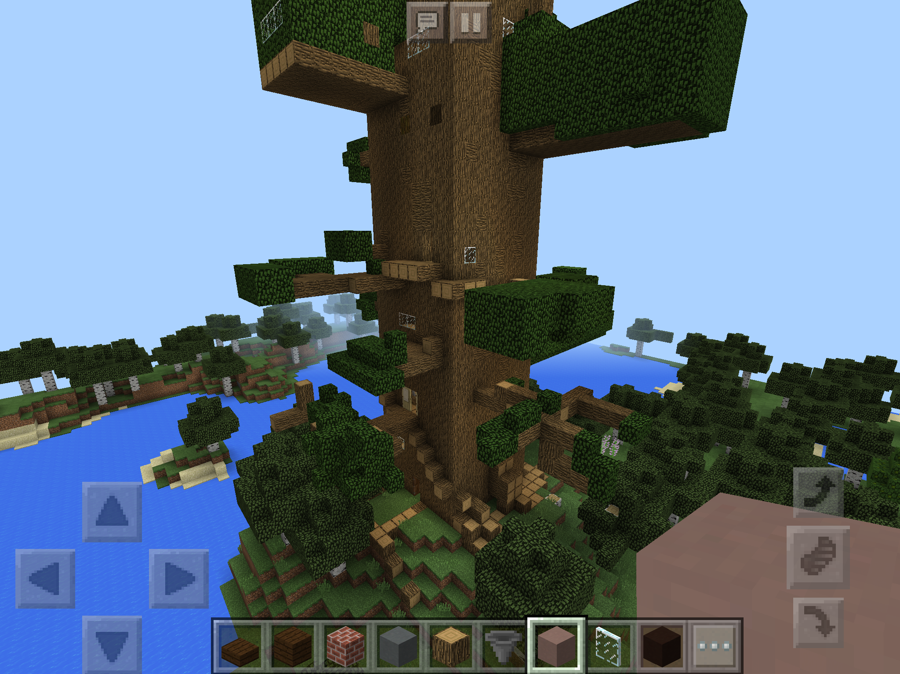

Slide 4
Screen time can be:
Interactive – for example, playing video games, communicating via Skype, or using online tools to draw pictures
Non-interactive – for example, sitting still and watching movies, TV programs or YouTube videos
Recreational – for example, playing games or watching videos for fun.

Slide 8
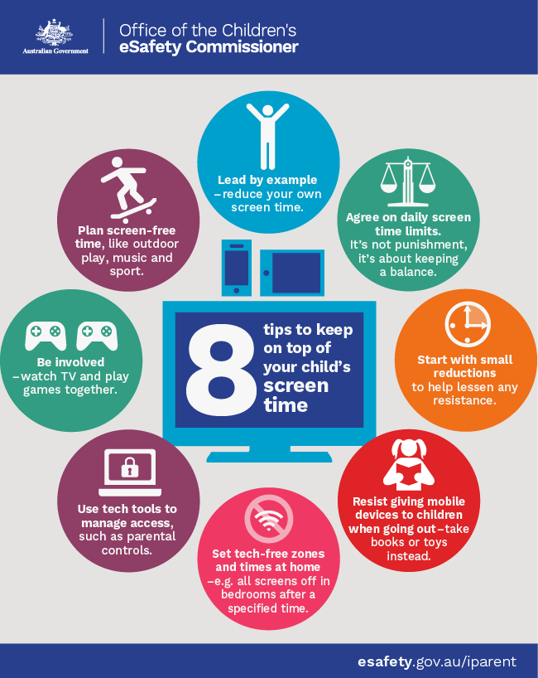
Openly discuss
Screens and internet usage with your children.

Slide 9
Child accounts and family sharing Restrictions Guided Access Screen Guide Internet Supplier restrictions

Slide 10
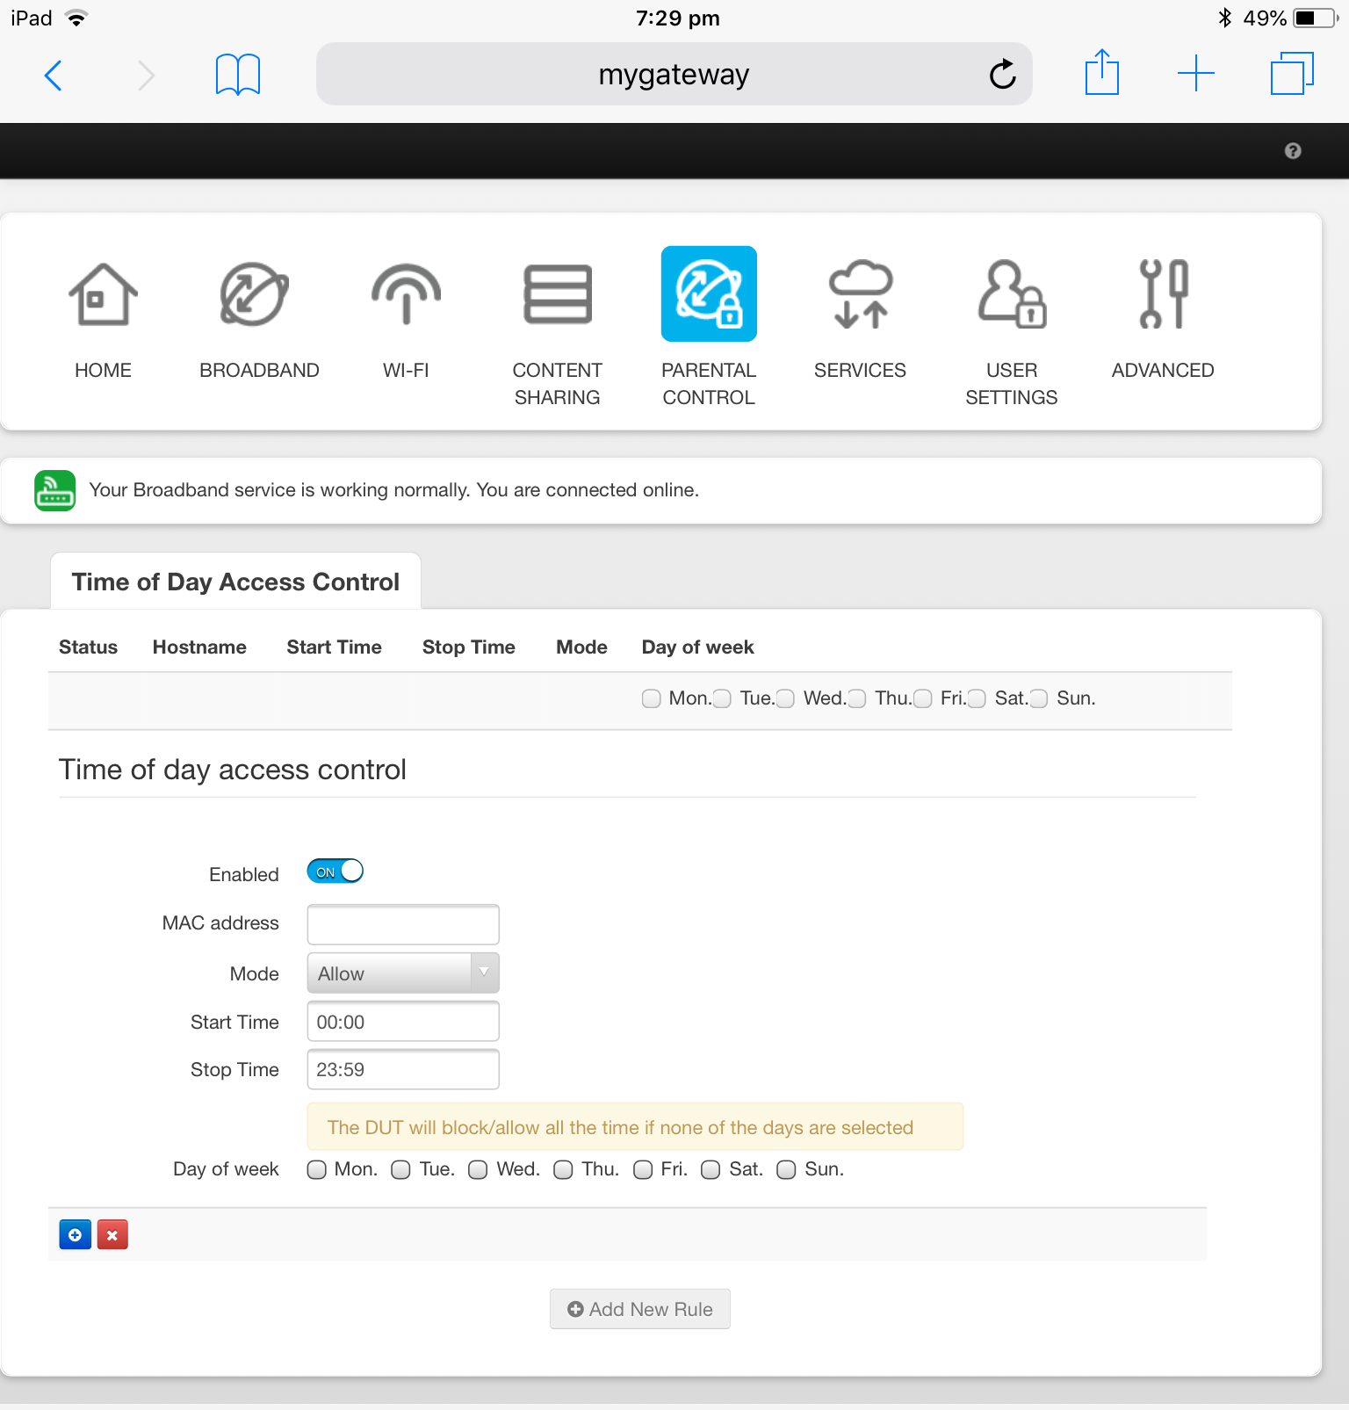
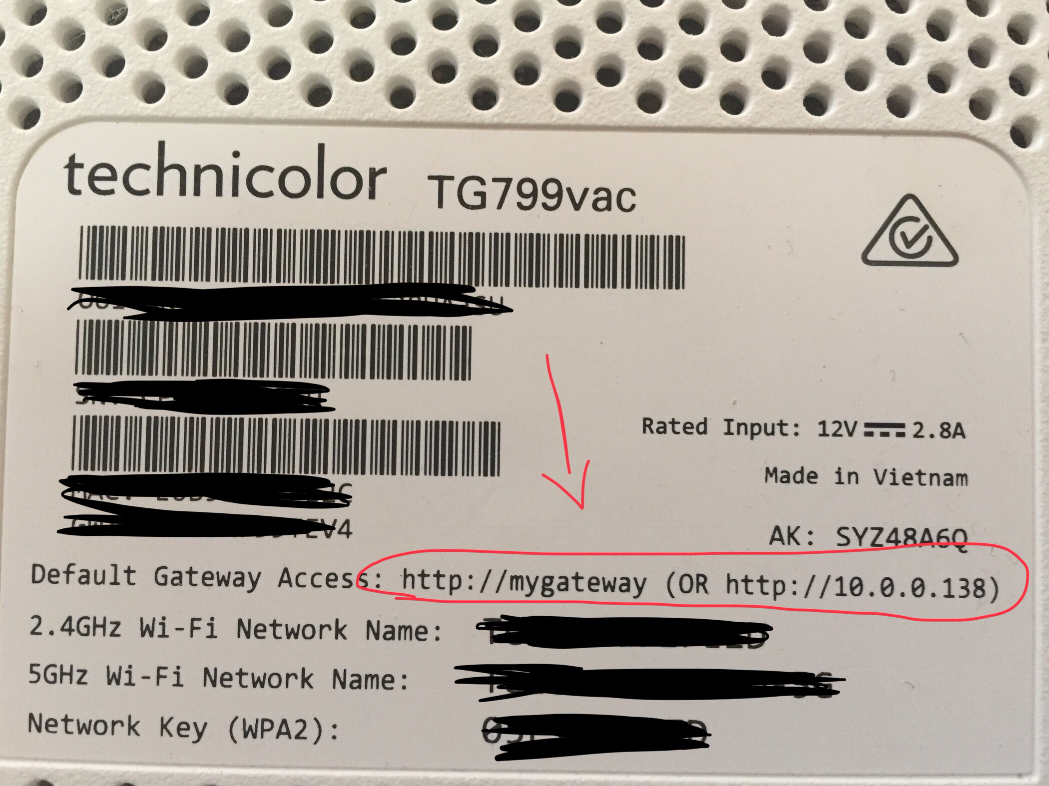
Internet supplier restriction
All different but are common with NBN services

Slide 11
CyberBullying – What is it?
Types of cyberbullying
Cyberbullying is the act of repeatedly bullying using digital technologies including mobile phones, email and social media tools. Cyberbullying includes:
Pranking
Repeated hang ups, anonymous, mocking or threatening phone calls.
Image sharing
Forwarding or sharing unflattering or private images without permission.
Sexually explicit images
People of any age, who forward or share images of a sexual nature of a person under 18 need to be aware that this is a criminal offence (child pornography) that may result in prosecution.
Text and email
Sending insulting or threatening text messages or emails.

Slide 12
CyberBullying – What is it? (cont'd)
Personal online information​
Publishing online someone's private, personal or embarrassing information without permission, or spreading rumours online.​
Identity theft​
Assuming someone’s identity online and negatively representing them in a way that damages their reputation or relationships.​
Hate sites​
Creating hate sites or implementing social exclusion campaigns on social networking sites.​

Slide 13
What can I do?
Monitor and discuss your child's usage on their devices.
1
Most cyberbullying occurs behind closed doors and is unknown to the parent.
Set Restrictions/ check the privacy settings and/or block the chat features.
2
Report the Cyberbullying to the media service
3
Collect Evidence
- Take Screen Shots
4
Report to the appropriate services.
-Police
- School
- E-safety commissioner
5

Slide 14
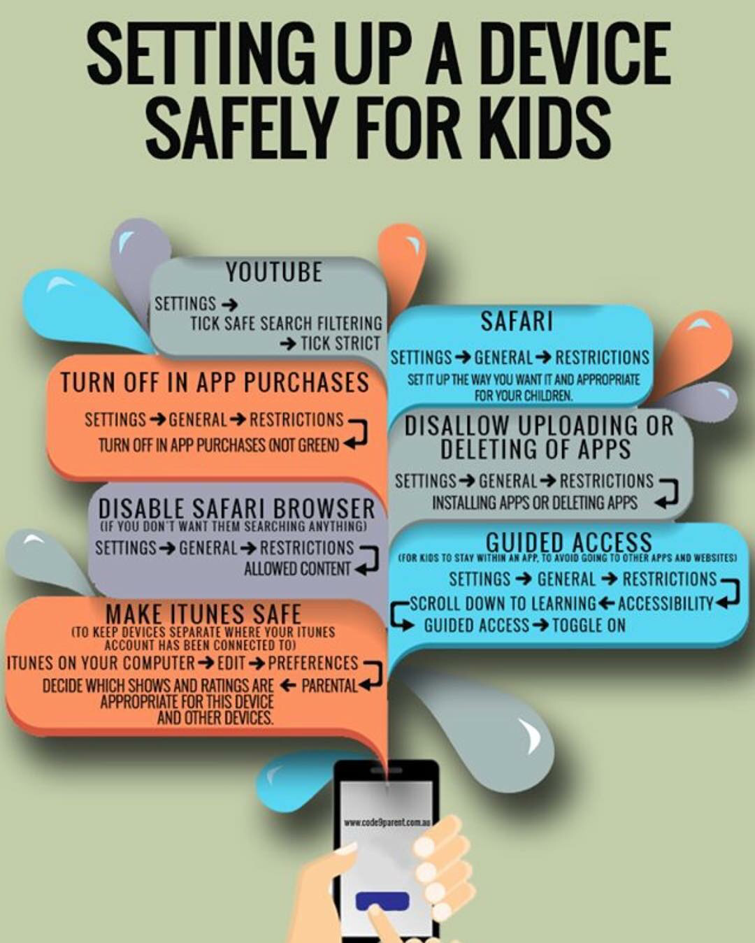
Parent resources
https://esafety.gov.au/education-resources/iparent\
www.code9parent.com.au

